Slide 1

Orientation to Computing-I
L T P :2 0 0
www.lpu.in Lovely Professional University

Slide 2

Unit-4 (Computer Network and Communication)
Network types (wired and wireless), Network topologies, Network communication devices (Routers, Switches, Modems, Hubs, access point),
Setting IP addresses, sharing files and folders, Remote Login, SSH, Wireless Security (http vs
https), Client Server model, Types of Servers (Proxy servers, Application server, Web server,
File server, Database server, Synchronization server, Log server).
www.lpu.in Lovely Professional University

Slide 3
Unit-4 (Cloud Computing)
Types of Cloud ( Public, Private, Hybrid, Community)
Cloud based services( SaaS, PaaS, IaaS, FaaS)
Virtualization Types
Hypervisor Types ( Type 1 and Type 2)
Major Cloud service providers
www.lpu.in Lovely Professional University

Slide 4
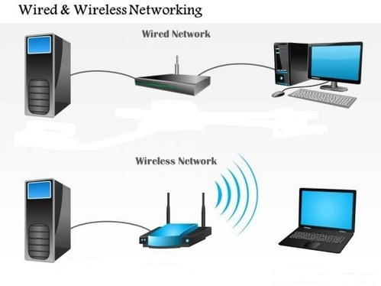
Types of Network
www.lpu.in Lovely Professional University

Slide 5
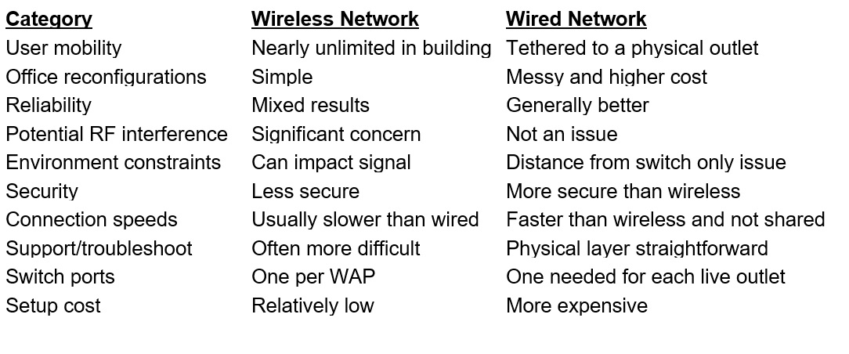
Types of Computer Network
www.lpu.in Lovely Professional University

Slide 6
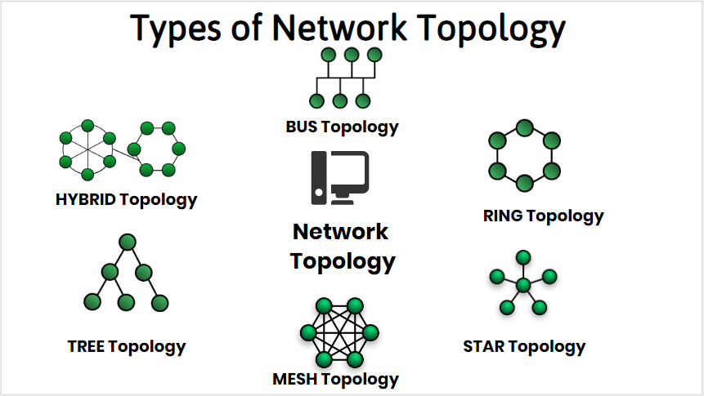
Network Topologies
www.lpu.in Lovely Professional University

Slide 7
Types of Network Topologies
Bus Topology: Bus topology is the kind of network topology where every node, i.e. every device on the network, is connected to a solo main cable line
Ring Topology :Ring Topology is a topology type in which every computer is connected to another computer on each side.
Star Topology: Star Topology is the kind of network topology in which all the nodes are connected via cables to a single node called a hub, which is the central node. The hub can be active or passive in nature.
Mesh Topology: Mesh topology is the kind of topology in which all the nodes are connected with all the other nodes via a network channel.
Tree Topology: Tree topology is the topology in which the nodes are connected hierarchically, with all the nodes connected to the topmost node or root node.
Hybrid Topology :A Hybrid Topology is basically a network topology comprising two or more different types of topologies. It is a reliable and scalable topology, but simultaneously, it is a costly one.
www.lpu.in Lovely Professional University

Slide 8

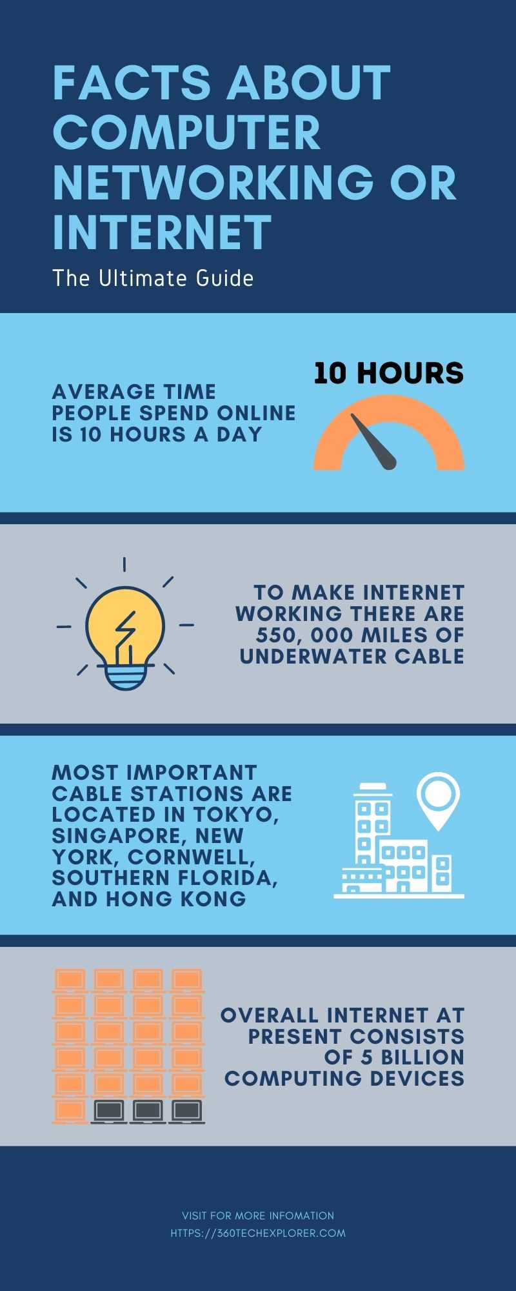
Notes:
The Internet consists of five billion computing devices such as computers, phones, modems, switches, routers, etc

Slide 9
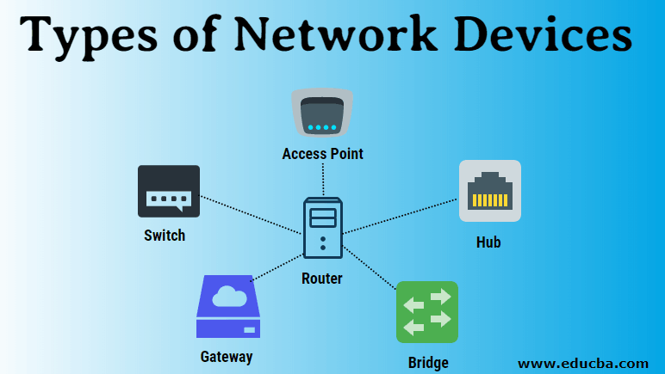
Network Communication Devices
There are different types of network devices through which the transmission occurs. These devices act as intermediates between the source and destination. These devices are also sometimes referred to as nodes or hosts and paths to find out the best paths which help them for communication.
Router: It is also known as a layer-3 device of the Open Standard Interface (OSI) model. It adds the source and destination address with the data packets it receives. This facilitates the data packets to easily reach to their corresponding destination.
www.lpu.in Lovely Professional University

Slide 10
Network Communication Devices
Hub: It is a layer-2 device of the OSI model. It sends the frames (layer-2) to all the devices connected to a network. Hubs are usually used by LAN to connect it’s all segments. It is comprised of multiple ports so that whenever any fame arrives at one port, it is copied to the other ports so that all segments of the LAN can see all packets.
Switch: A switch is another important networking device which is commonly known as intelligent Hub. It also works on layer -2 of OSI model but it maintains the record of all Media Access Control (MAC) addresses of the connected devices, therefore whenever the same device sends the request for transmission through a switch it checks its record if the entry of the MAC address of that device is found it send the data to that destination immediately on the other hand if the entry is not found it adds the new entry for the newly connected device. This function makes a switch more efficient than a Hub
www.lpu.in Lovely Professional University

Slide 11
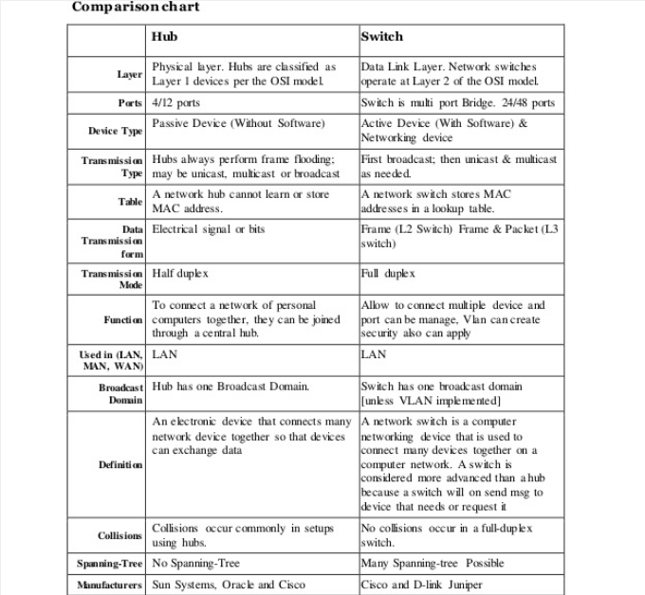
Difference
www.lpu.in Lovely Professional University

Slide 12
Network Communication Devices
Modems: It is a device that enables a computer to send or receive data over telephone or cable lines. The data stored on the computer is digital whereas a telephone line or cable wire can transmit only analog data. The main function of the modem is to convert digital signal into analog and vice versa..
Access Points: It is a device that creates a wireless local area network, or WLAN, usually in an office or large building. An access point connects to a wired router, switch, or hub via an Ethernet cable, and projects a Wi-Fi signal to a designated area.
www.lpu.in Lovely Professional University

Slide 13
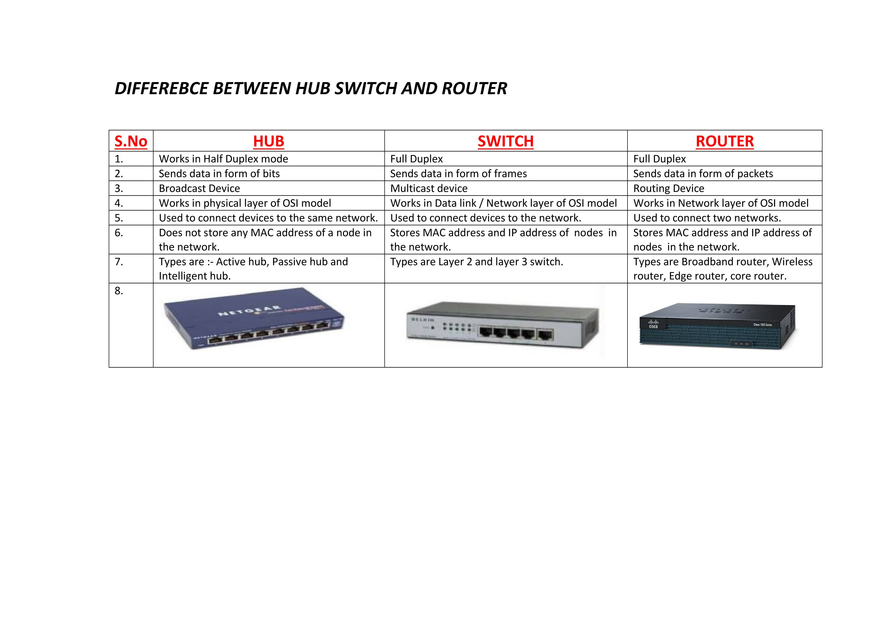
Difference
www.lpu.in Lovely Professional University

Slide 14
Activity-1
Show in packet tracer how topologies and networks work by sending data packets/ simple execution at tutor’s end……
www.lpu.in Lovely Professional University

Slide 15
Setting IP Address
To set the IP address within Windows XP and Windows 2000, complete these steps….
Click Start >Settings >Control Panel.
On the control panel, double-click Network Connections.
Right-click Local Area Connection.
Click Properties.
Select Internet Protocol (TCP/IP), and then click Properties.
Select Use the Following IP Address.
Complete the IP address, Subnet mask, and Default gateway fields by using the values in step 4 from Accessing the ASMI using a Web Browser.
Click OK on the Local Area Connection Properties window. It is not necessary to restart your PC.
www.lpu.in Lovely Professional University

Slide 16
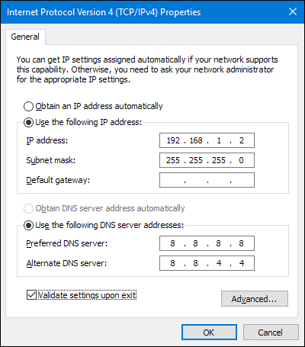
Activity -2 (Setting up your IP address)
www.lpu.in Lovely Professional University
Notes:
https://www.ibm.com/docs/en/power5?topic=browser-setting-ip-address-your-pc-mobile-computer

Slide 17
Activity-3 Sharing Files and Folders
File sharing over a network in Windows 10 allows you to share files and folders on your computer with other users over a private or public network in your workgroup or domain.
You can set the permissions of a shared file or folder to allow groups or users to have a read only, change (modify), or full control access rights.
Starting with Windows 10 version 1803, some features of file sharing over a network have changed, including the removal of HomeGroup. However, even though HomeGroup has been removed, you can still share printers and files by using features that are built into Windows 10.
Right-click (or long-press) a file, and then select Show more options > Give access to > Specific people.
Select a user on the network to share the file with, or select Everyone to give all network users access to the file..
www.lpu.in Lovely Professional University

Slide 18
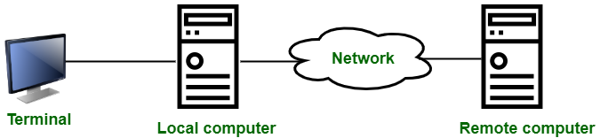
Remote Login
Remote Login is a process in which user can login into remote site i.e. computer and use services that are available on the remote computer.
With the help of remote login a user is able to understand result of transferring result of processing from the remote computer to the local computer.
www.lpu.in Lovely Professional University

Slide 19
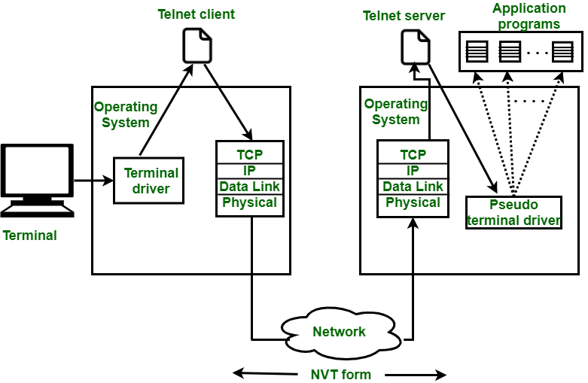
Activity-4 -Procedure of Remote Login :
www.lpu.in Lovely Professional University

Slide 20
Activity-4
It is implemented using Telnet.
Procedure of Remote Login :
When the user types something on local computer, then local operating system accepts character.
Local computer does not interpret the characters, it will send them to TELNET client.
TELNET client transforms these characters to a universal character set called Network Virtual Terminal (NVT) characters and it will pass them to the local TCP/IP protocol Stack.
Commands or text which is in the form of NVT, travel through Internet and it will arrive at the TCP/IP stack at remote computer.
Characters are then delivered to operating system and which later on passed to TELNET server.
www.lpu.in Lovely Professional University

Slide 21
Activity-4
Then TELNET server changes that characters to characters which can be understandable by remote computer.
Remote operating system receives character from a pseudo-terminal driver, which is a piece of software that pretends that characters are coming from a terminal.
Operating system then passes character to the appropriate application program.
www.lpu.in Lovely Professional University

Slide 22

Approximately 204 million emails per minute are sent over the Internet. 70% of them are spam

Slide 23
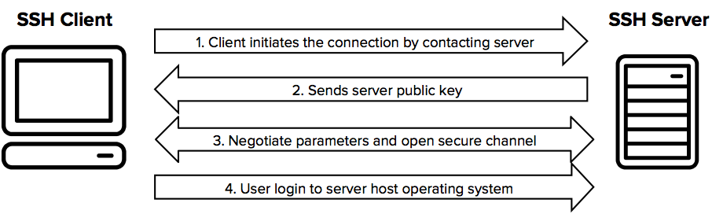
Secure Socket Shell (SSH)
SSH, also known as Secure Shell or Secure Socket Shell, is a network protocol that gives users, particularly system administrators, a secure way to access a computer over an unsecured network.
SSH also refers to the suite of utilities that implement the SSH protocol.
Secure Shell provides strong password authentication and public key authentication, as well as encrypted data communications between two computers connecting over an open network, such as the Internet.
www.lpu.in Lovely Professional University

Slide 24
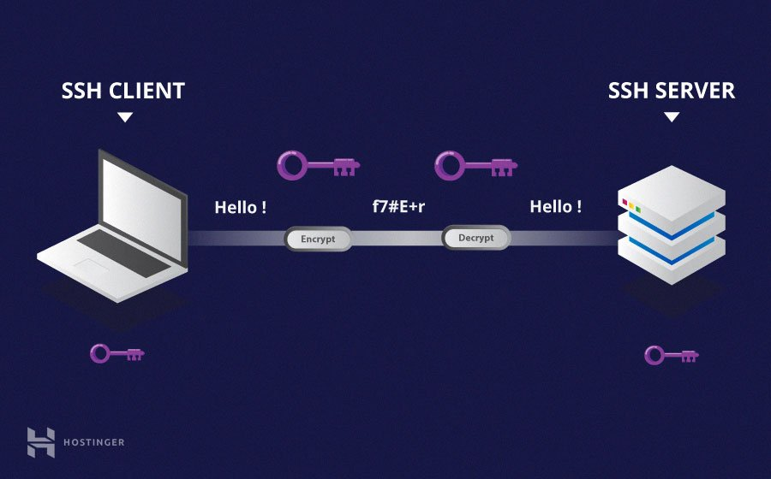
Understanding Different Encryption Techniques
www.lpu.in Lovely Professional University
Notes:
https://www.hostinger.com/tutorials/ssh-tutorial-how-does-ssh-work

Slide 25
Wireless Security
Wireless network security is the process of designing, implementing and ensuring security on a wireless computer network.
It is a subset of network security that adds protection for a wireless computer network.
Wireless network security primarily protects a wireless network from unauthorized and malicious access attempts.
Typically, wireless network security is delivered through wireless devices (usually a wireless router/switch) that encrypts and secures all wireless communication by default.
Even if the wireless network security is compromised, the hacker is not able to view the content of the traffic/packet in transit. Moreover, wireless intrusion detection and prevention systems also enable protection of a wireless network by alerting the wireless network administrator in case of a security breach
www.lpu.in Lovely Professional University

Slide 26
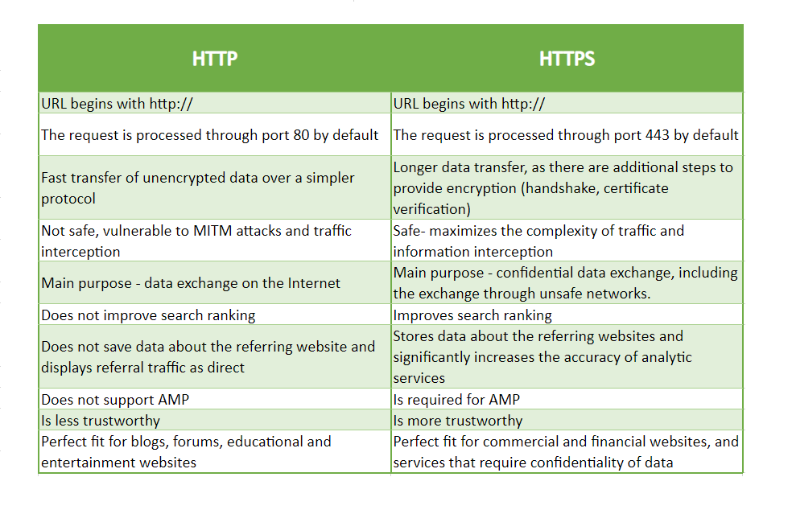
HTTP vs HTTPs
www.lpu.in Lovely Professional University

Slide 27
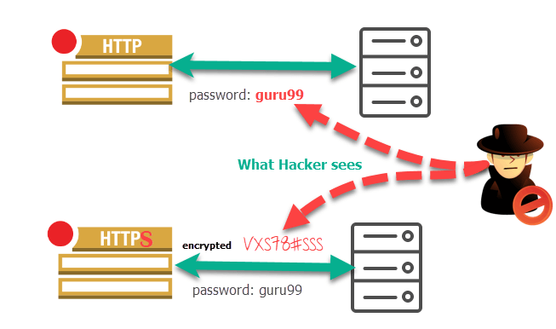
HTTP vs HTTPs
www.lpu.in Lovely Professional University

Slide 28
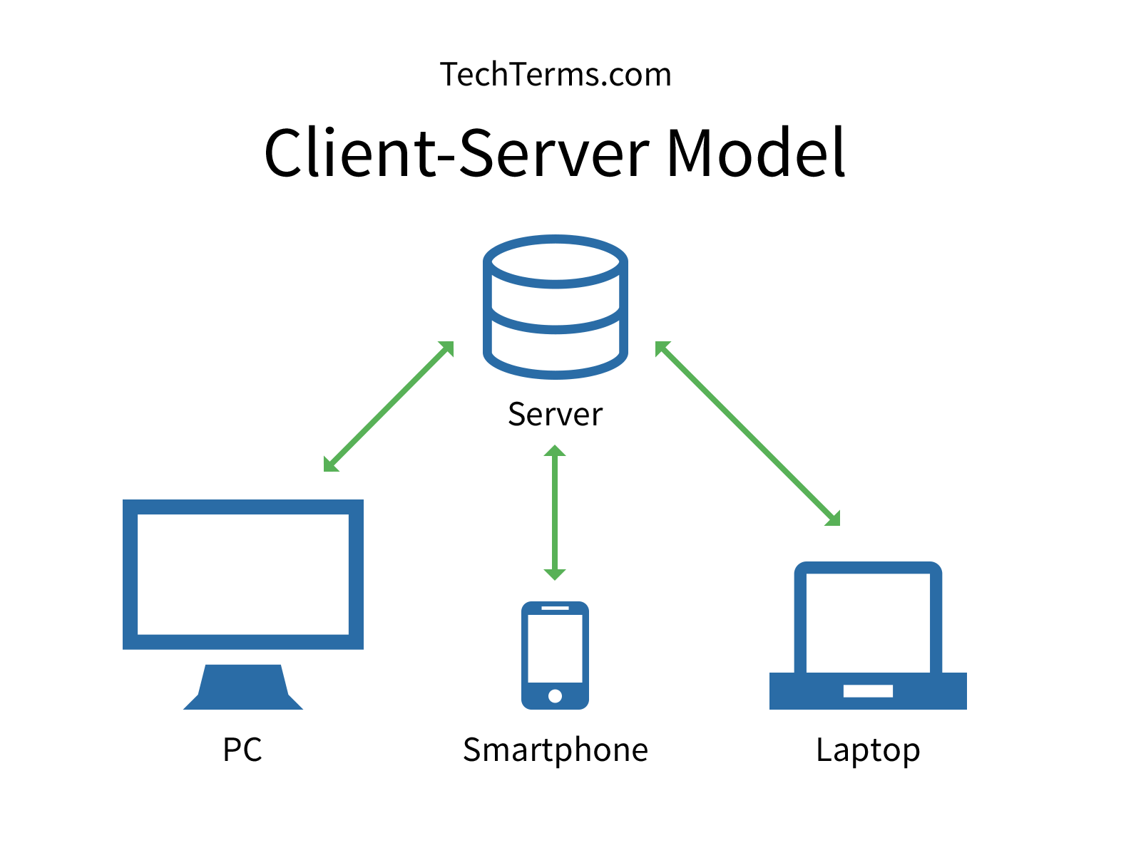
Client Server Model
The Client-server model is a distributed application structure that partitions task or workload between the providers of a resource or service, called servers, and service requesters called clients.
In the client-server architecture, when the client computer sends a request for data to the server through the internet, the server accepts the requested process and deliver the data packets requested back to the client. Clients do not share any of their resources. Examples of Client-Server Model are Email, World Wide Web, etc.
www.lpu.in Lovely Professional University

Slide 29
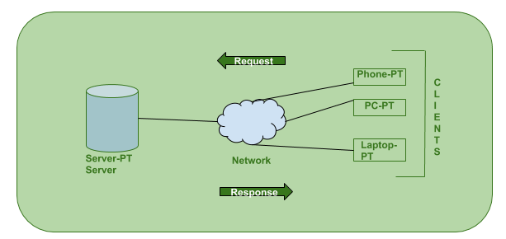
Working of Client Server Model
The Client-server model is a distributed application structure that partitions task or workload between the providers of a resource or service, called servers, and service requesters called clients.
In the client-server architecture, when the client computer sends a request for data to the server through the internet, the server accepts the requested process and deliver the data packets requested back to the client. Clients do not share any of their resources. Examples of Client-Server Model are Email, World Wide Web, etc.
www.lpu.in Lovely Professional University
Notes:
https://www.geeksforgeeks.org/client-server-model/

Slide 30
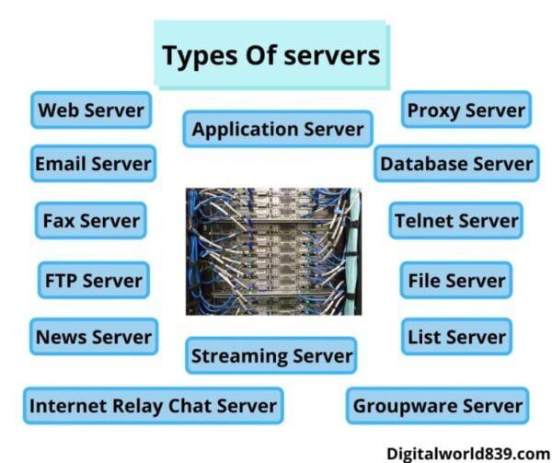
www.lpu.in Lovely Professional University

Slide 31
Types of Server
Proxy server commonly called “proxy”. It acts as a gateway between users and the internet. These types of servers are used for performance enhancement, privacy, and anonymous surfing. When a client connects to a proxy server and requests a service, its accessing IP address changes.
Application Server is a framework, it is an environment where applications run. Application Server includes a server operating system (OS) and server hardware that provides computing-intensive operations and other services to the application.
A web server is a server that runs on websites. It is also called a computer program. The main function of web servers is to store, process, and deliver.Whenever we search on the internet through web browsers like chrome, Mozilla, internet explorer, etc, receives the request for the URL and then web server sends the data according to the need of the user. These types of servers mainly show the data in format like images, text, video, etc.
www.lpu.in Lovely Professional University

Slide 32
Types of Server
A file server is a network that helps to transfer stored files. The file server stores and manages all the files in a computer and sends a copy of the file to the other computer on the request of the users. It shares the storage of computer files such as documents, sound files, photographs, images, databases, etc. These types of servers is used mainly on the local network.
A database server runs a database management system and provides database services to clients. The server manages data access and retrieval and completes clients’ requests.
Server synchronization allows to synchronize the database of two servers located on different systems. In this way, several servers can be synchronized with each other one after the other.
www.lpu.in Lovely Professional University

Slide 33
Types of Server
A log server is a log file automatically created and maintained by a server consisting of a list of activities it performed. It maintains a huge server requests.
Information about the request, including client IP address, request date/time, the page requested, HTTP code, bytes served, user agent, and referrer are typically added to the log server format.
This data can be combined into a single file, or separated into distinct logs, such as an access log, error log, or referrer log. server logs typically do not collect user-specific information.
These files are usually not accessible to general Internet users, only to the administrative person of Internet service.
A statistical analysis of the server log may be used to examine traffic patterns by time of day, day of the week, referrer, or user agent.
www.lpu.in Lovely Professional University
Notes:
https://medium.com/softifybd/what-is-a-log-server-and-why-it-is-important-ff1df13fac87

Slide 34
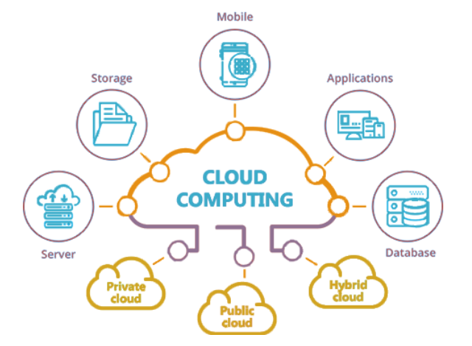
Cloud Computing
Cloud computing is the on-demand delivery of IT resources over the Internet with pay-as-you-go pricing. Instead of buying, owning, and maintaining physical data centers and servers, you can access technology services, such as computing power, storage, and databases, on an as-needed basis from a cloud provider like Amazon Web Services (AWS).
www.lpu.in Lovely Professional University

Slide 35
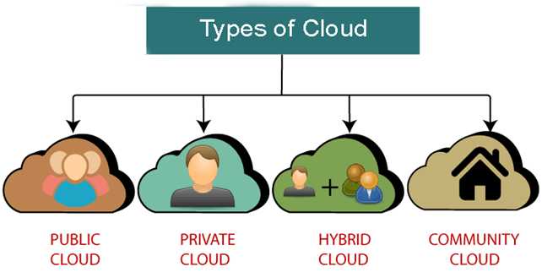
Types of Cloud
Public cloud is open to all to store and access information via the Internet using the pay-per-usage method.
Private cloud is also known as an internal cloud or corporate cloud. It is used by organizations to build and manage their own data centers internally or by the third party.
Hybrid Cloud is a combination of the public cloud and the private cloud.
Community cloud allows systems and services to be accessible by a group of several organizations to share the information between the organization and a specific community.
www.lpu.in Lovely Professional University

Slide 36
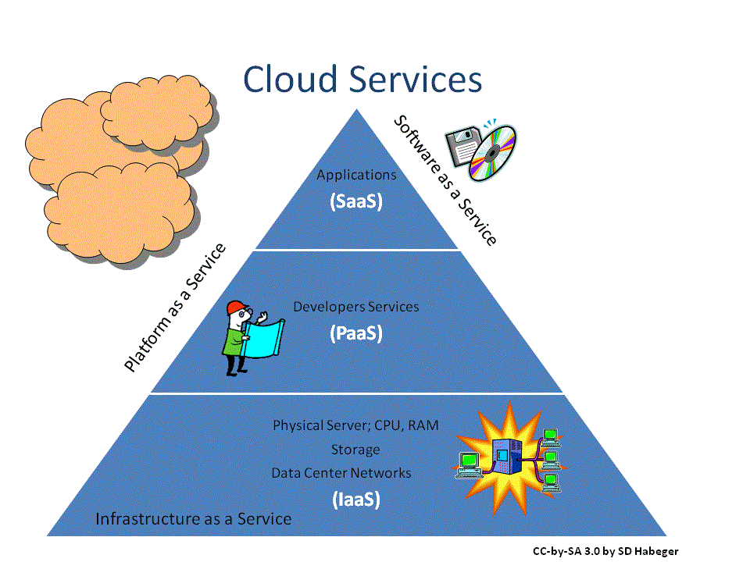
Cloud Service Models
www.lpu.in Lovely Professional University

Slide 37
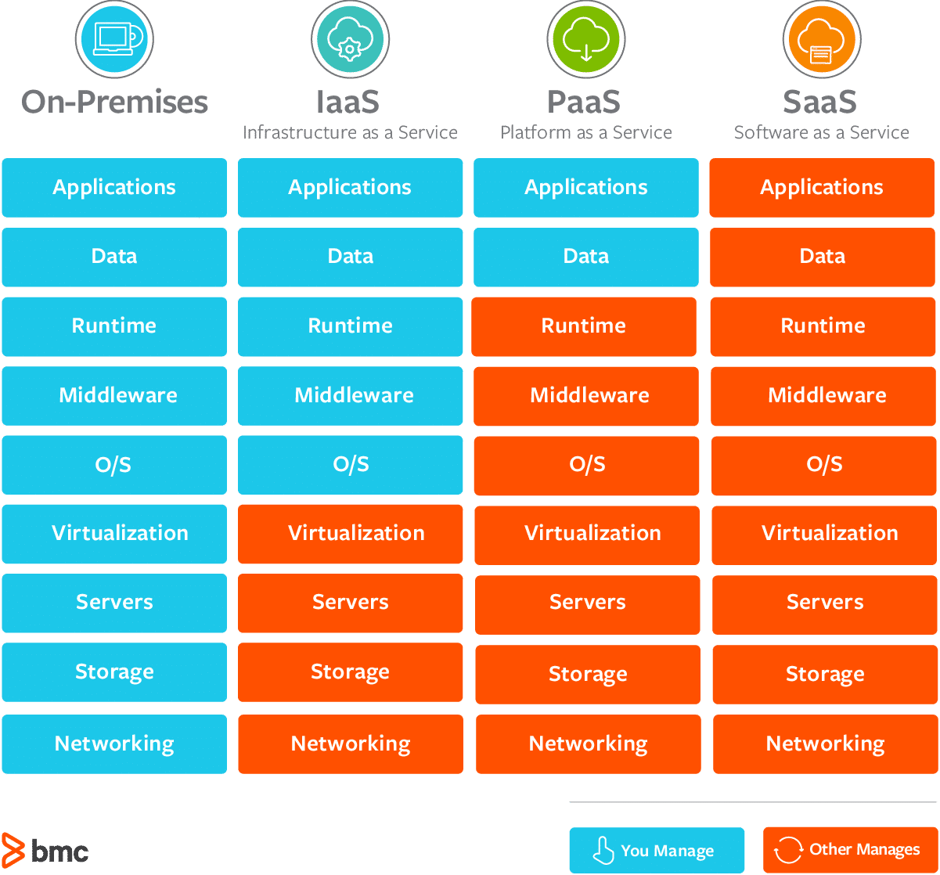
Comparison of Cloud Service Models
www.lpu.in Lovely Professional University

Slide 38
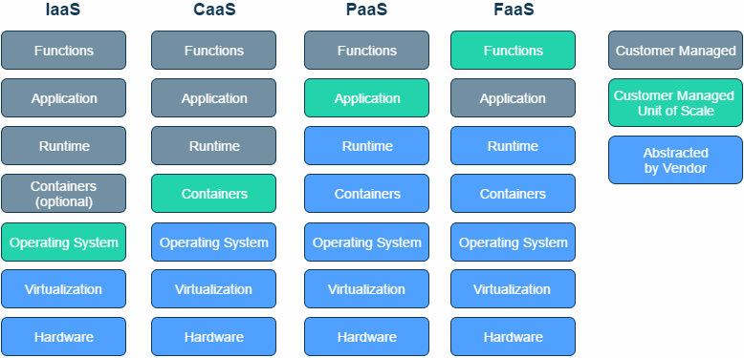
Comparison of Cloud Service Models
www.lpu.in Lovely Professional University

Slide 39
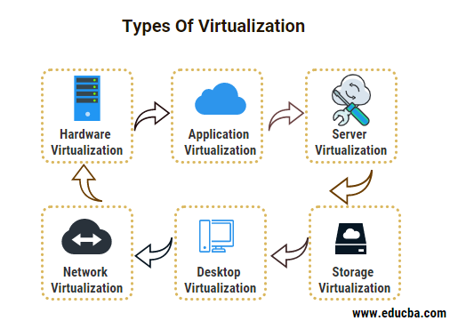
Types of Virtualization
Virtualization is the technology to generate virtual instances of computer resources for multiple uses of the same physical resource. There are several virtualization technologies available that are capable of virtualizing the server, storage, networks, and operating systems.
www.lpu.in Lovely Professional University

Slide 40
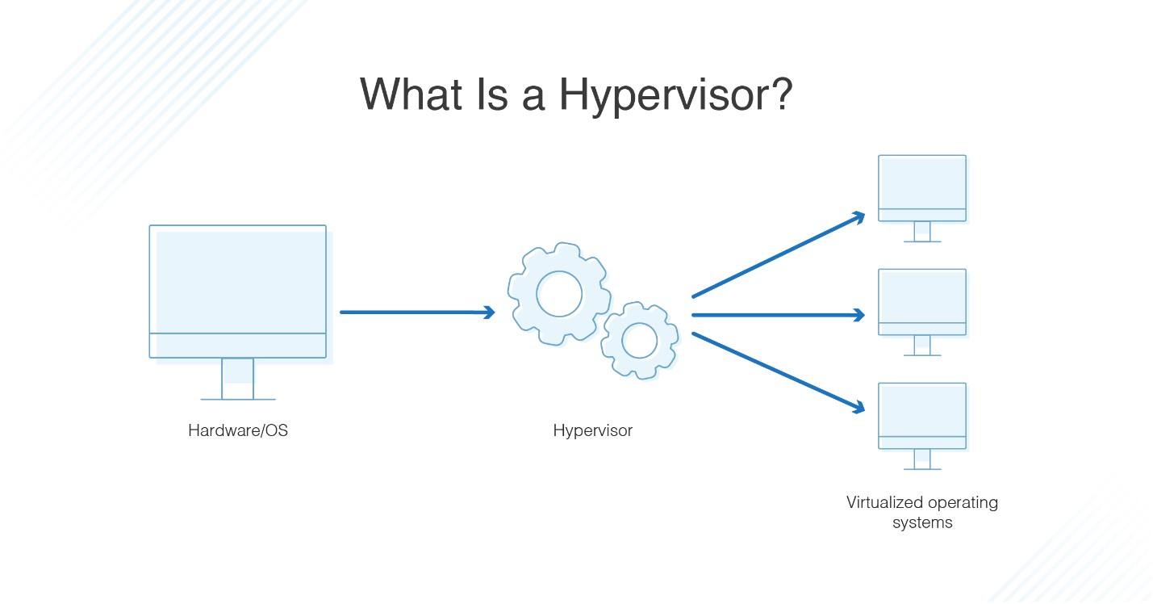
Hypervisor
A hypervisor is hardware, software, or firmware capable of creating virtual machines and then managing and allocating resources to them. Virtual machines are machines set up to use the resources of the host machine.
www.lpu.in Lovely Professional University

Slide 41
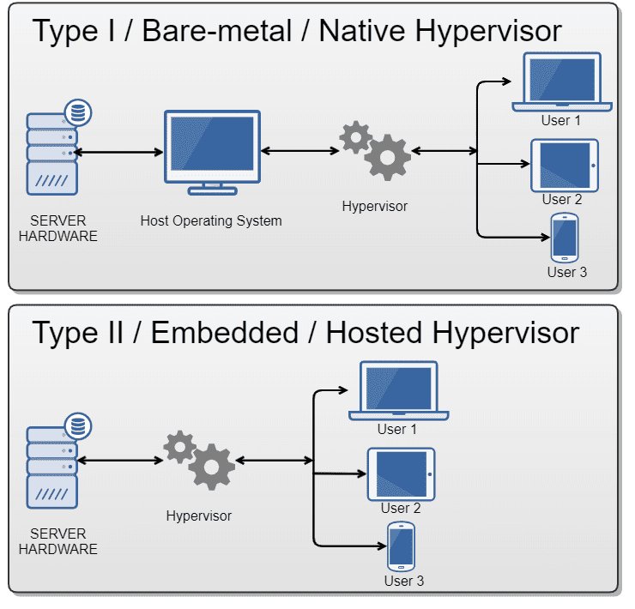
Types of Hypervisor
www.lpu.in Lovely Professional University

Slide 42
How Does a Hypervisor Work?
They operate on the server level and can be either physical or virtual, and hardware or software-defined.
They load the client operating systems of the VMs.
It distributes the computing resources such as CPU, memory, bandwidth, and disk storage for each of the VMs. It does this by creating pools of hardware resources, which it then allocates to VMs.
VMs can create requests for the hypervisor through API calls.
www.lpu.in Lovely Professional University

Slide 43
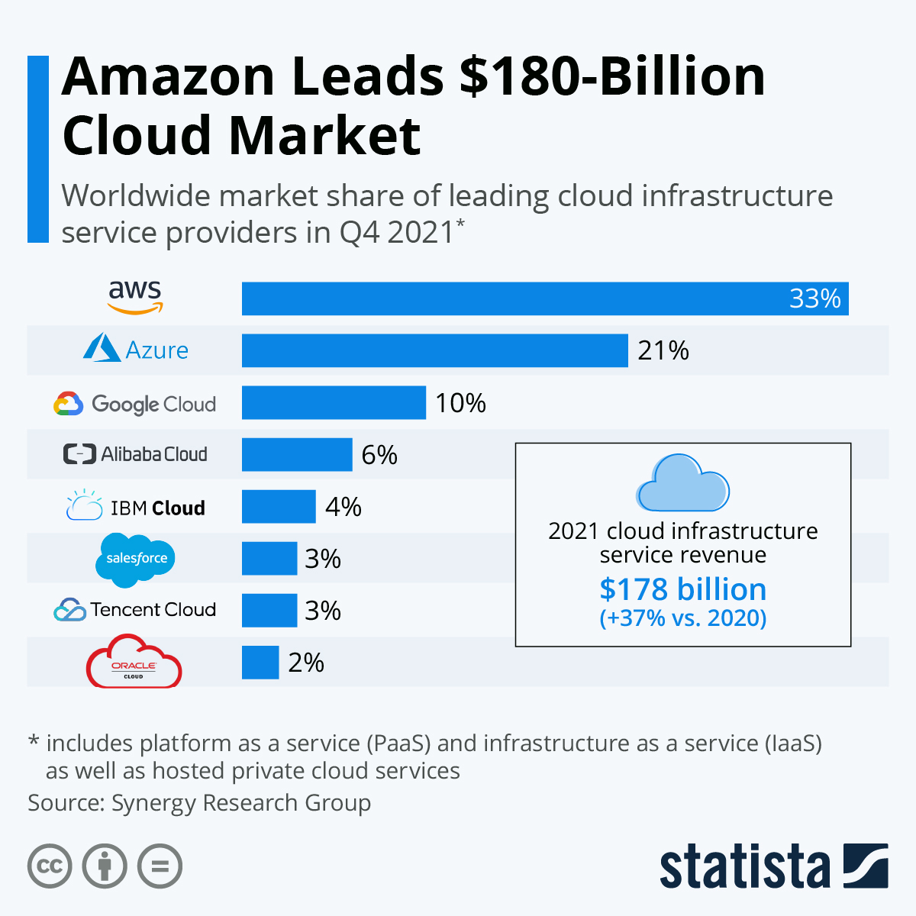
World Wide Cloud Market
www.lpu.in Lovely Professional University

Slide 44
Activity 5
Discussion on different websites such as google docs, mail, etc for reference of concepts

